Slide 1
HR ANALYTICS EMPLOYEE RETENTION ANALYSIS
PRESENTED BY(Group – 6):-
VINITH KUMAR P R
CHINMAI SHIVAJI DANDEKAR
BABITHA KUDIKALA
ASWANTH N K
AKANSHA BANSAI
AFRIN IQUABAL SHEIKH
BHUKYA PRAVEEN

Slide 2
INDEX
INTRODUCTION
KPI’S
DASHBOARDS
OBSERVATION
CONCLUSION
INTRODUCTION
In today's rapidly evolving business world, talent management has become a critical strategic imperative. As we kick off our Employee Retention Analysis project, it's essential to acknowledge the significant shifts in how organizations approach attracting, retaining, and nurturing their workforce. The traditional model of employment, characterized by long-term loyalty to a single company, has given way to a more dynamic and competitive landscape.

Slide 3
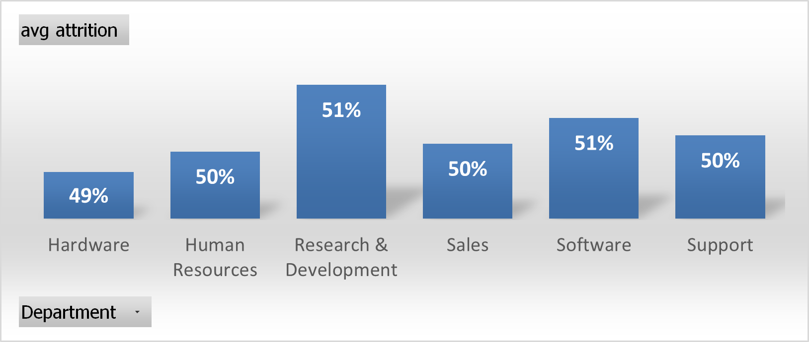
AVERAGE ATTRITION RATE FOR ALL DEPARTMENT
Average attrition rate is around 50%, which means about half of employees leave or transit roles each year.
When we look at different departments, we see some differences. For example, Hardware team has a lower attrition rate at 49%, indicating good stability, while Research and Development and Software have slightly higher rates at 51%, suggesting potential retention challenges.
These differences might be due to workload, job satisfaction, or growth opportunities unique to each department.
To address this, we'll develop strategies tailored to each department's needs to maintain a stable and content workforce.

Slide 4
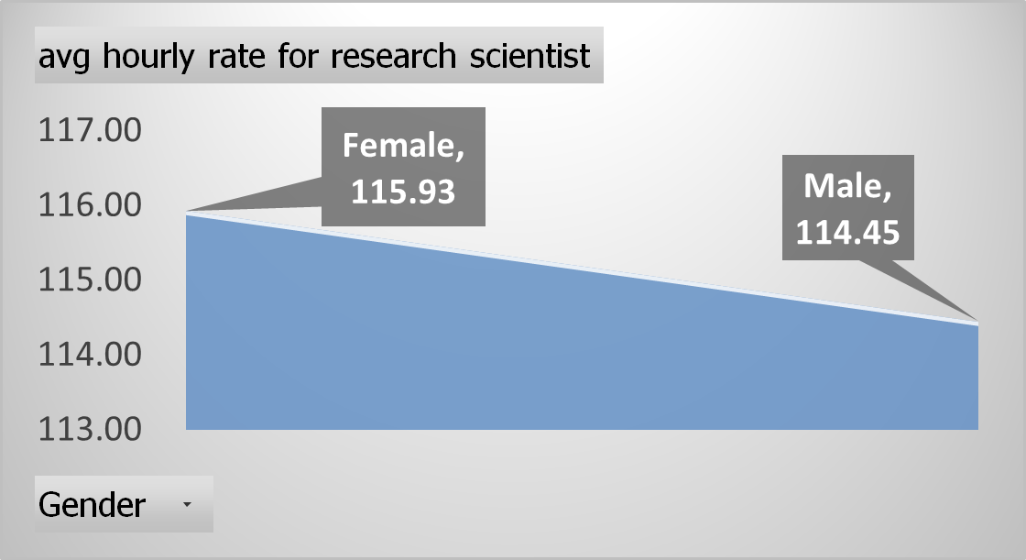
AVERAGE HOURLY RATE OF MALE AND FEMALE RESEARCH SCIENTIST
The data shows a minimal difference in the average hourly rate between male and female research scientists, with males earning $115.93 per hour and females earning $114.45 per hour.
This suggests that, on average, there is a relatively small gender pay gap in the field of research science.
While there is still a gender pay gap, it's encouraging to see that the gap is narrow.
This indicates that progress has been made in achieving pay equity within the research science profession.
It's essential to continue efforts to close this gap further and promote equality in compensation for all scientists regardless of gender

Slide 5
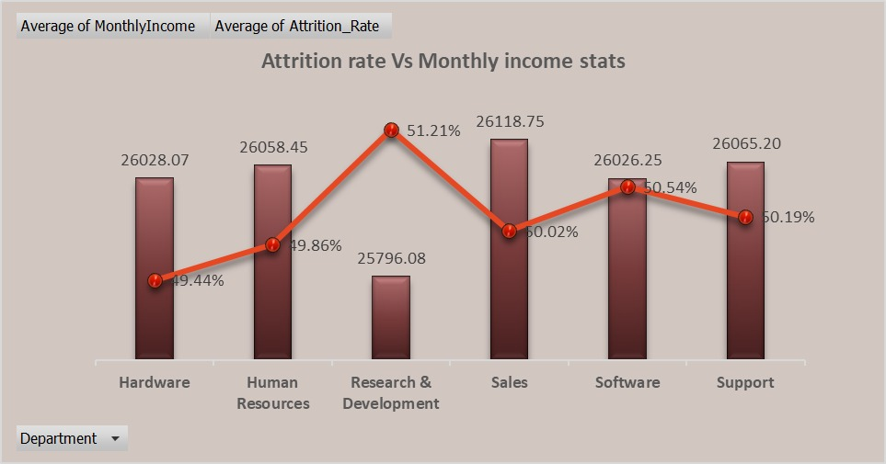
ATTRITION RATE VS MONTHLY INCOME STATS
The data shows variations in attrition rates among departments. While the Hardware department has the lowest attrition rate at 49%, Research and Development and Software have the highest at 51%.
This highlights the importance of understanding and addressing the unique factors influencing attrition in each department.
Despite the differences in attrition rates, the average monthly income across departments remains relatively stable, ranging from ₹25,796 to ₹26,118.
This suggests that monthly income alone may not be the primary driver of attrition and that other factors, such as job satisfaction or career development opportunities, may play a significant role.

Slide 6
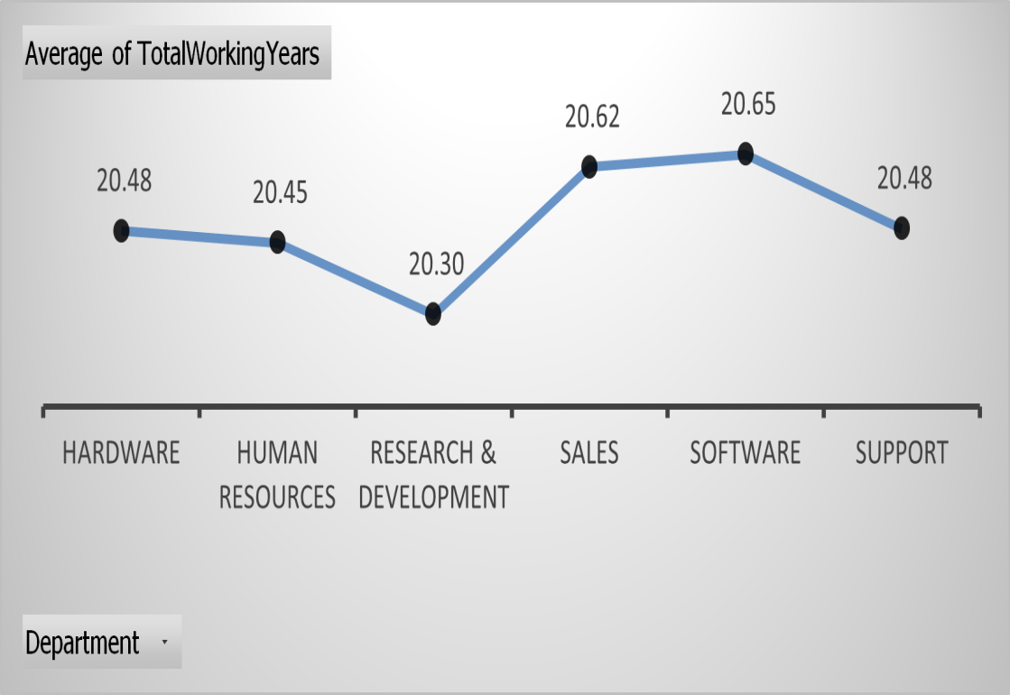
AVERAGE WORKING YEARS FOR EACH DEPARTMENT
The average working years in the company across various departments show remarkable stability, with hardware (20.48 years), human resources (20.45 years), and support (20.48 years) all clustering around the 20-year mark.
This consistency suggests a balanced and enduring workforce, which can positively impact organizational knowledge retention and internal expertise.
Sales and software departments stand out with slightly higher average working years (20.62 and 20.65 years, respectively).
This indicates a strong commitment of employees in these departments, potentially reflecting a culture of long-term career growth and development.
Leveraging this experienced talent pool could lead to innovative sales strategies and cutting-edge software development.

Slide 7
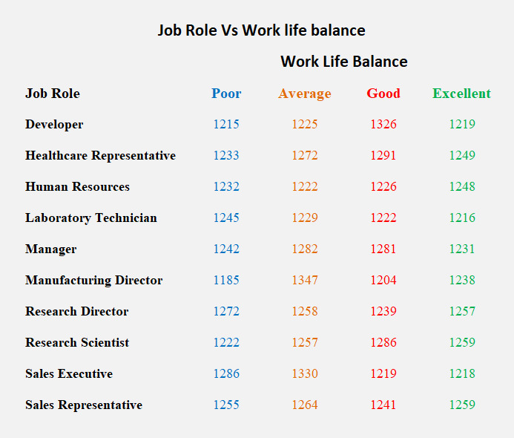
JOB ROLE VS WORK LIFE BALANCE
Based on the data, job roles that tend to have a better work-life balance are healthcare representatives and human resources professionals, with average scores above 1,230.
On the other hand, roles like manufacturing directors and sales executives tend to have poorer work-life balance, with average scores below 1,250.
It's important to note that work-life balance can vary significantly within each job role.
For example, while the average work-life balance score for research scientists is around 1,256, there is a notable range within this role, with some individuals reporting excellent work-life balance (score above 1,280) and others experiencing a poorer balance (score below 1,240).
This highlights the importance of individual factors and company policies in determining work-life balance, even within the same job category.

Slide 8
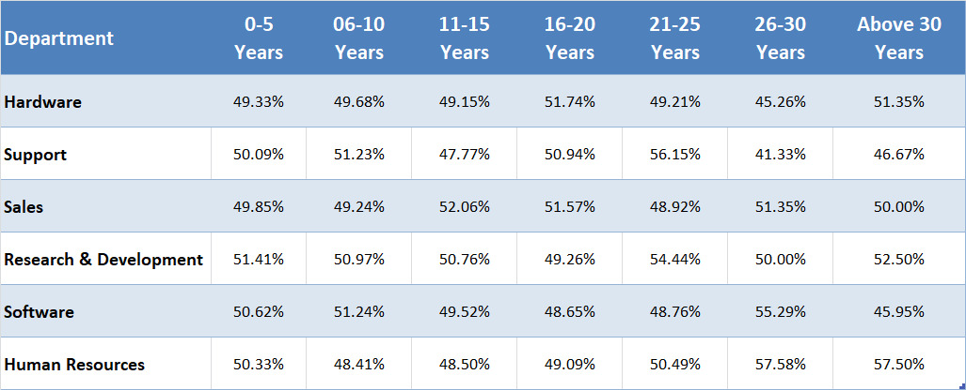
ATTRITION RATE VS YEAR SINCE LAST PROMOTION RELATION
For 0-5 years since Last year Promotion interval Research & Development and Hardware departments has highest and lowest attrition rate respectively.
For 6-10 years since last year promotion interval Human resources and software departments has highest and lowest attrition rate respectively.
For 11-15 years since last promotion interval support and sales departments has highest and lowest attrition rate respectively.
For 16-20 years since last promotion interval software & hardware departments has highest and lowest attrition respectively.
For 21-25 years since last promotion interval software and support departments has highest and lowest attrition respectively.
For 26-30 years since last promotion interval support and Human resources departments has highest and lowest attrition respectively.
For above 30 years since last promotion interval software and Human resources departments has highest and lowest attrition respectively.

Slide 9
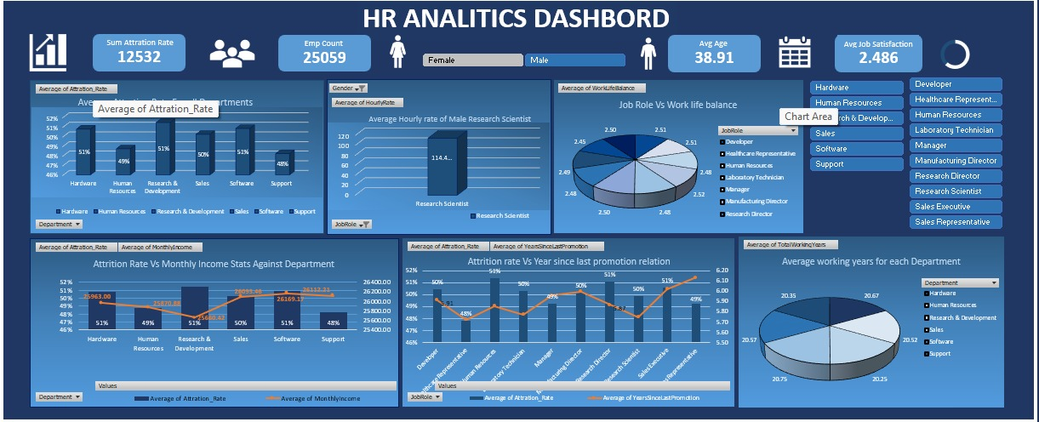
EXCEL DASHBOARD

Slide 10
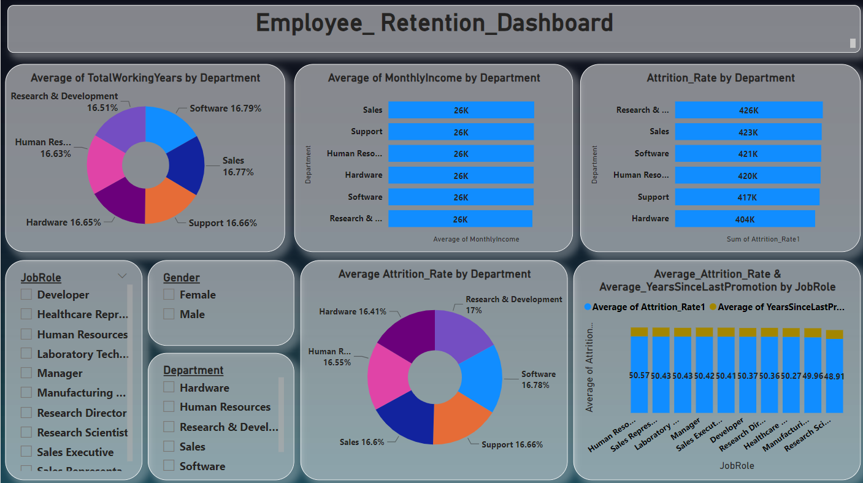
POWER BI DASHBOARD

Slide 11
OBSERVATION
Attrition rates vary significantly based on the number of years since the last promotion. In the 0-5 years since the last promotion interval, Research & Development has the highest attrition rate, while Hardware has the lowest.
For employees in the 6-10 years since the last promotion interval, Human Resources experiences the highest attrition rate, whereas Software has the lowest. This suggests potential challenges in retaining mid-career professionals.
In the 11-15 years since the last promotion interval, Support has the highest attrition rate, while Sales has the lowest. This indicates that employees with moderate experience levels might face retention challenges in the Support department.
Over longer career spans (16-20 years since the last promotion interval), Software consistently has the lowest attrition rate, while Hardware has the highest. This highlights the department's potential for retaining experienced employees.
In the 21-25 years and above 30 years since the last promotion intervals, Software maintains the lowest attrition rate. However, it's noteworthy that Human Resources shows higher attrition in both of these categories, indicating challenges in retaining employees with extensive experience.
To address attrition effectively, it's crucial to develop department-specific strategies based on employees' years since their last promotion. This data can guide targeted interventions to improve workforce stability.

Slide 12
CONCLUSION
Our analysis shows a clear correlation between the number of years since the last promotion and attrition rates. Understanding this relationship is essential for devising effective retention strategies.
Departments like Human Resources face higher attrition rates among employees with 6-10 years of experience. Tailored retention efforts should be directed towards this demographic.
Software consistently exhibits lower attrition rates across various experience brackets, highlighting the department's ability to retain experienced professionals. This could serve as a model for other departments.
To combat attrition effectively, it's essential to develop retention strategies customized to each department's unique needs. This data-driven approach can lead to a stable and content workforce.
The Human Resources department faces attrition challenges, especially among employees with extensive experience. Special attention is required to retain these valuable team members.
Attrition is a dynamic issue, and it's crucial to regularly assess and adjust retention strategies to align with changing workforce demographics and needs.

Slide 13
THANK YOU

